Slide 1
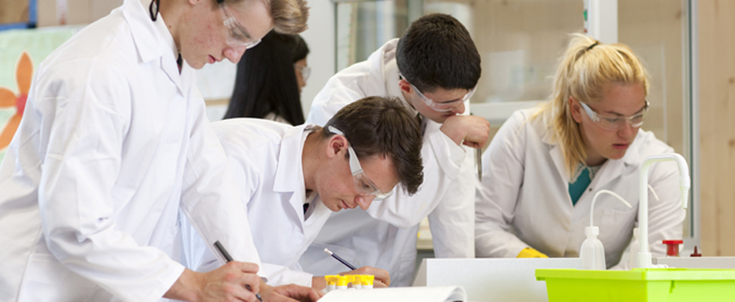
GCSE Science
Year 9 Options Explained

Slide 2
GCSE Science Options
The new GCSE course limits choice from previous years.
Choice of either:
GCSE Triple Science
(3 GCSEs)
GCSE Combined Science
(2 GCSEs)
Triple
Combined

Slide 3
GCSE Triple Science: Advantages
GCSE Biology, Chemistry & Physics offers students:
A firm foundation to go on to study A-level Biology, Chemistry, Physics (Grade 6 required).
13 periods of science a fortnight compared to 8 in CS
(Bio 5, Che 4, Phy 4 due to Bio’s larger content).
Generally students will have more time in class to learn larger content and skills.
More required practicals – 28 in Triple science
(21 in combined science).

Slide 4
GCSE Triple Science: Advantages
Specialist teachers in each subject
(All teachers can teach all subjects up to GCSE but the knowledge of the A level course helps to bridge GCSE to higher content).
All students have elected to be in triple science classes and are enthusiastic about subjects.
Students will more than likely have the same teachers going into A Level and have already developed a good working relationship.

Slide 5
GCSE Triple Science: Advantages
Same no. of exams - 6 papers
Triple Science 1h45 (100 marks)
Combined Science 1h15 (70marks)
You can change tier (F/H) for different subjects
Students will receive separate grades for each subject.
Smaller class sizes

Slide 6
Triple
Combined
Y9 Options
GCSE Science Choice
To select GCSE Triple Science students need a minimum grade of a grade 4 in Year 9.
The Combined Science course covers the majority of the triple science course content.
Students this year have moved between combined and triple science at the early stages of the course.

Slide 7
GCSE Combined Science
More flexibility in curriculum to take other subjects.
8 periods a fortnight on two subject and then taught combined third subject.
If students receive a lower than expected grade to take them into A Level. We will look at individual grades in subject to determine if grade was a 6 or above.
2 specialist teachers in some cases but all teachers are able to teach all of the GCSE Science content.
21 practical’s and shorter exams.
Ability set classes to allow more 1-2-1 with lower ability groups.

Slide 8
Guardians of the Galaxy Theme
Y10 Theme Example
10TS1 Star Lord 10TS2 Rocket Raccoon 10TS3 Groot 10DS1 Drax 10DS2 Gamora 10DS3 Ronan 10DS4 Thanos
Classes are given name on theme.

Slide 9
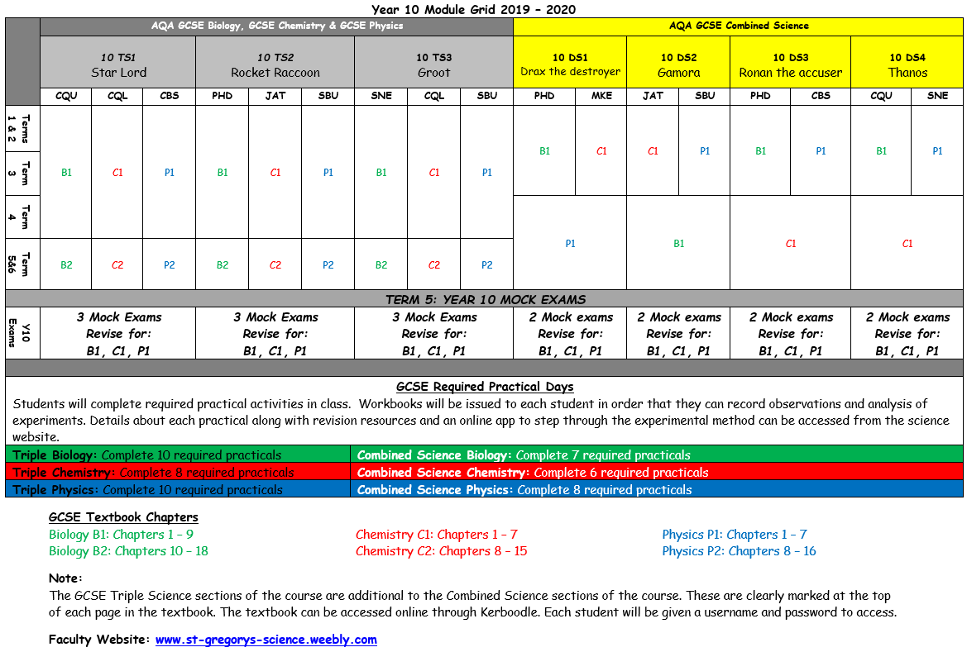
Module Grid

Slide 10
GCSE Triple Science Exam Schedule
Module | Teacher | Paper details | Weighting
Physics Paper 1, Paper 2 | Mr Burn | 1 hour 45mins, 100 marks | 50% each
Biology Paper 1, Paper 2 | Mr Quirk | 1 hour 45mins, 100 marks | 50% each
Chemistry Paper 1, Paper 2 | Mrs Quibell | 1 hour 45mins, 100 marks | 50% each
Practical (28 Practicals) | Completed in Class | Internal Assessment | 0% but required
6 Exams in total all of which are sat in the summer term of year 11

Slide 11
GCSE Combined Science Exam Schedule
Module | Teacher | Paper details | Weighting
Physics Paper 1, Paper 2 | Mr Burn | 1 hour 15mins, 70 marks | 16.7% each
Biology Paper 1, Paper 2 | Mr Dorney | 1 hour 15mins, 70 marks | 16.7% each
Chemistry Paper 1, Paper 2 | Mr Burn / Mr Dorney | 1 hour 15mins, 70 marks | 16.7% each
Practical (21 Practicals) | Completed in class | Internal Assessment | 0% but required
6 Exams in total all of which are sat in the summer term of year 11

Slide 12
GCSE Combined Science Practical Endorsement
There will be no coursework
Instead students will be assessed on their practical skills in their exams with 15% of the marks coming from questions relating to practical activities.
Students will be awarded a practical endorsement if they successfully complete a number of practical's which will not contribute to their overall grade.

Slide 13
GCSE Science Practical Endorsement
Triple Science Practical's:
10 Biology, 8 Chemistry, 10 Physics
Combined Science Practical's:
7 Biology, 6 Chemistry and 8 Physics
Students will need to make a record of their work and what they have learnt.

Slide 14
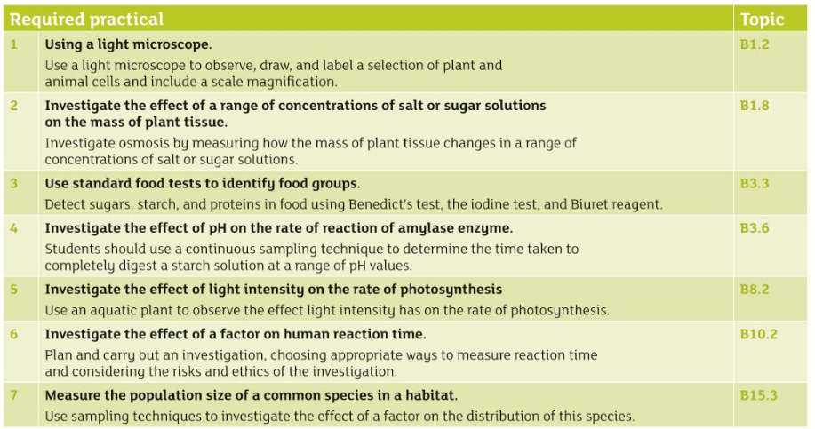
GCSE Combined Science Practical Endorsement
Biology (7 Practical's)

Slide 15
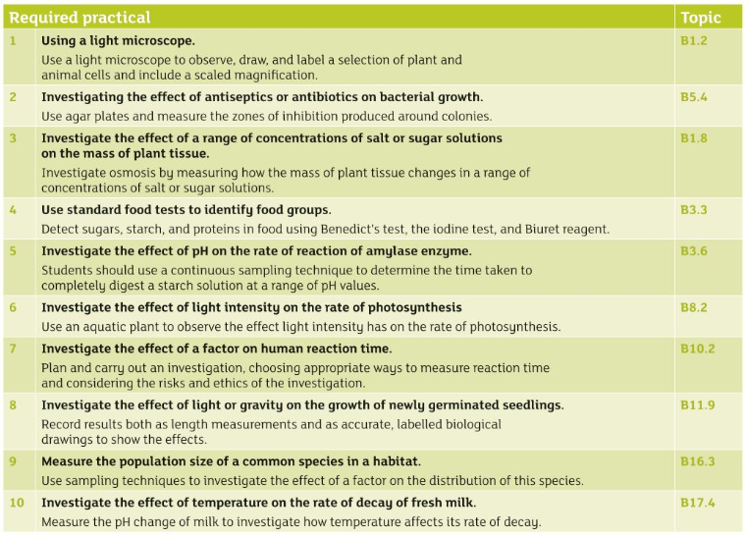
GCSE Triple Science Practical Endorsement
Biology (10 Practical's)

Slide 16
Welcome to Triple Science: Physics

Slide 17
4
Focus eLearning
Required Practical Simulations
Username: physics@st-gregorys.org.uk Password: stgregorys
5

Slide 18
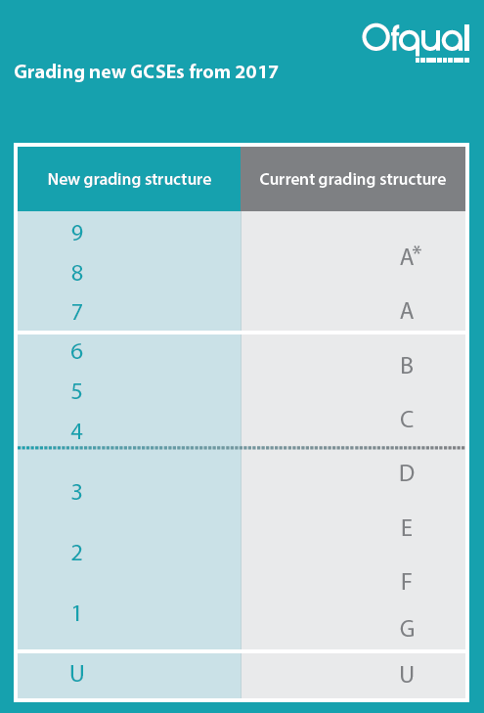
New Grading System
There will be Foundation and Higher Tier Exams.
A maximum grade 5 can be achieved in the Foundation Paper.

Slide 19
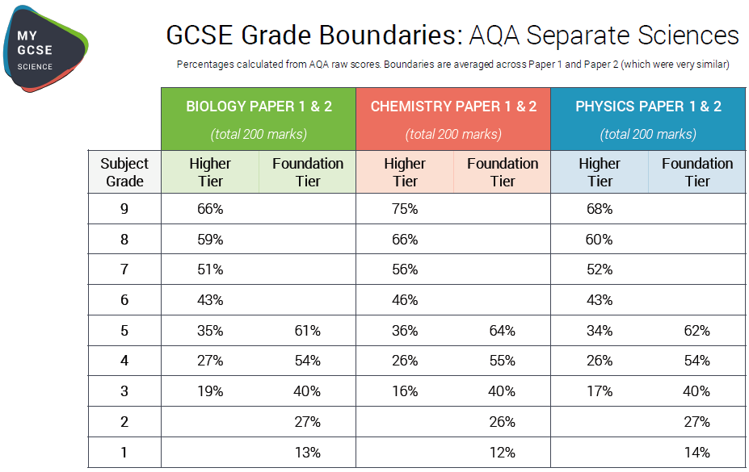

Slide 20
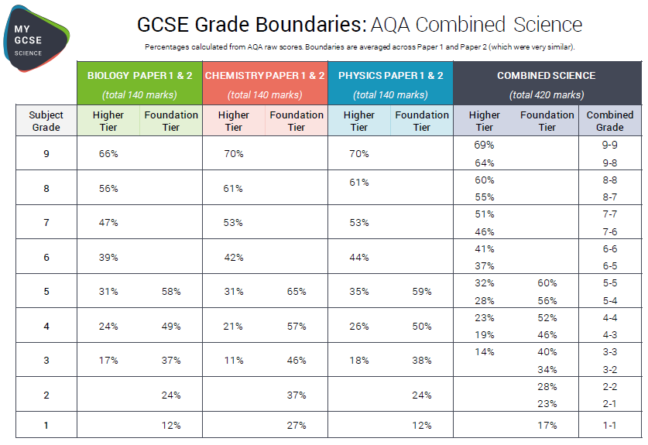

Slide 21
Q1. How many periods a fortnight does Combined Science have?
A. 7
B. 8
C. 9
D. 13

Slide 22
Q1. How many periods a fortnight does Combined Science have?
A. 7
B. 8
C. 9
D. 13

Slide 23
Q2. How many periods a fortnight does Triple Science have?
A. 10
B. 12
C. 13
D. 15

Slide 24
Q2. How many periods a fortnight does Triple Science have?
A. 10
B. 12
C. 13
D. 15

Slide 25
Q3. How many exams will you sit if you are on the Triple Science course?
A. 1
B. 3
C. 6
D. 9

Slide 26
Q3. How many exams will you sit if you are on the Combined Science course?
A. 1
B. 3
C. 6
D. 9

Slide 27
Q4. What grade do you need to get into A Level Science subjects?
A. 4
B. 6
C. 8
D. 9

Slide 28
Q4. What grade do you need to get into A Level Science subjects?
A. 4
B. 6
C. 8
D. 9

Slide 29
Q5. How many required practicals are required for Combined Science course?
A. 21
B. 23
C. 25
D. 28

Slide 30
Q5. How many required practicals are required for Combined Science course?
A. 21
B. 23
C. 25
D. 28

Slide 31
Q6. How many students in the current Y10 take Triple Science?
?

Slide 32
Q6. How many students in the current Y10 take Triple Science?
80
(88 Combined Scientists)

